Slide 1
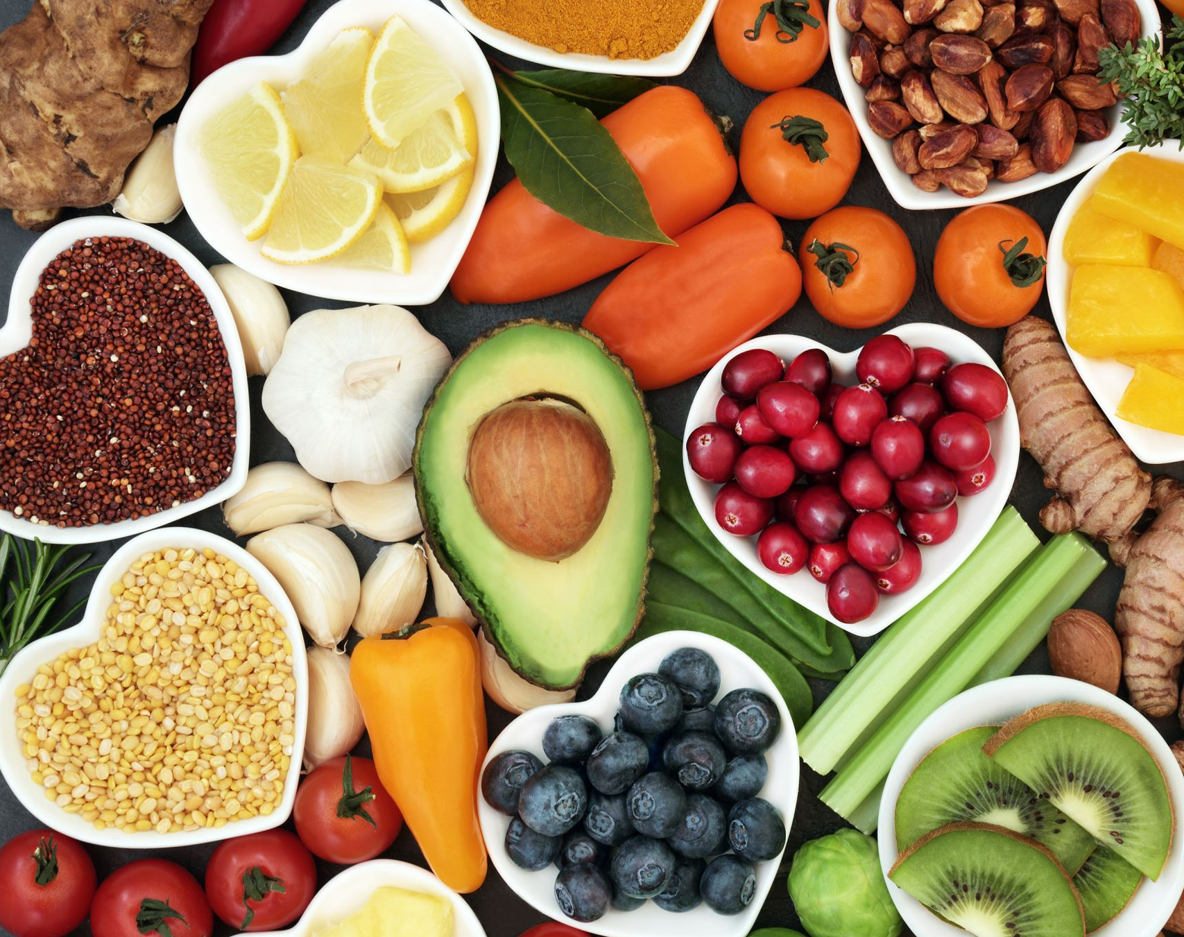
Food Management System
Team 1 (CosmosDB)
Pramita Sandhyan
Arpita Bhagat
Nishi Gandhi
Rhea Bajpai

Slide 2

Objective
The objectives of the project
Analyze Food Consumption Data
Optimize Supply Chain Management
Uncover restaurants that perform effectively.
Visualize Data with Microsoft Power BI

Slide 3
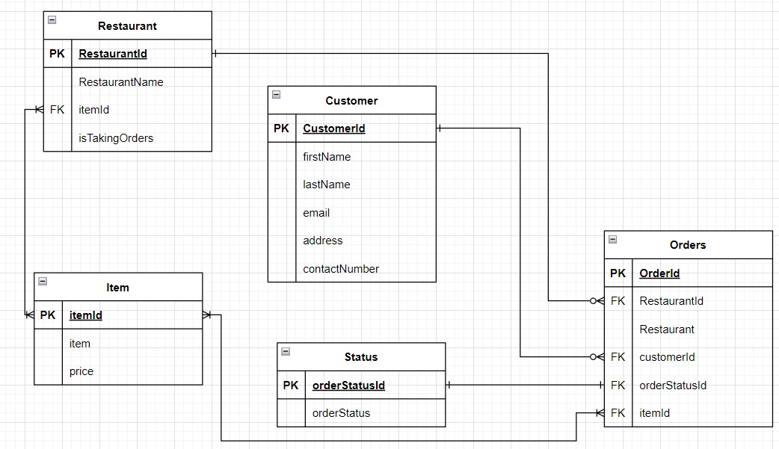
Entity Relationship Diagram

Slide 4
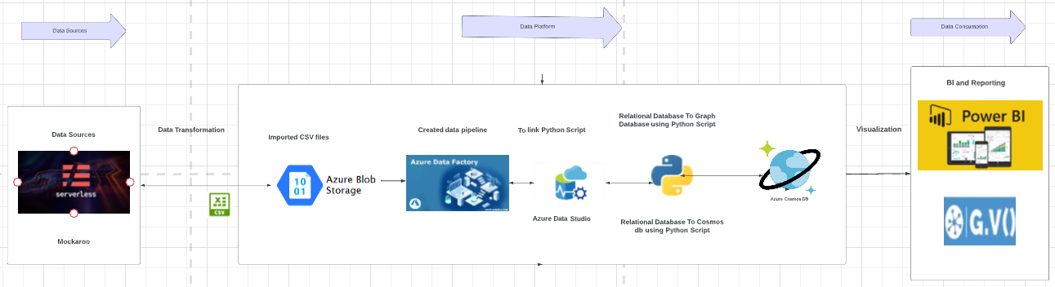
Data Architecture Diagram

Slide 5
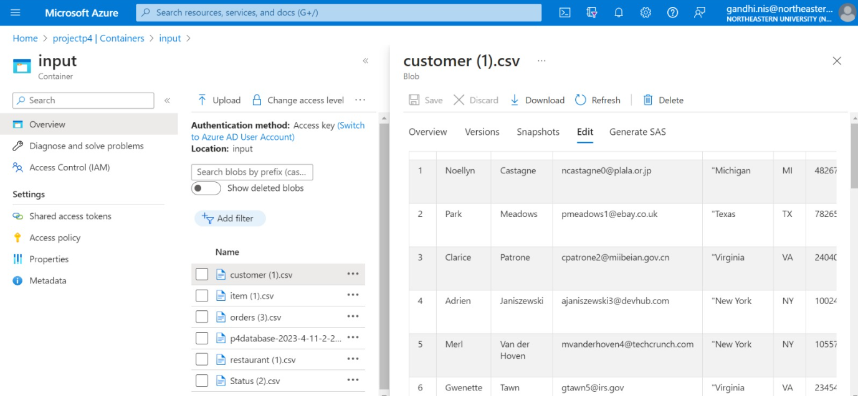
Azure Data studio

Slide 6
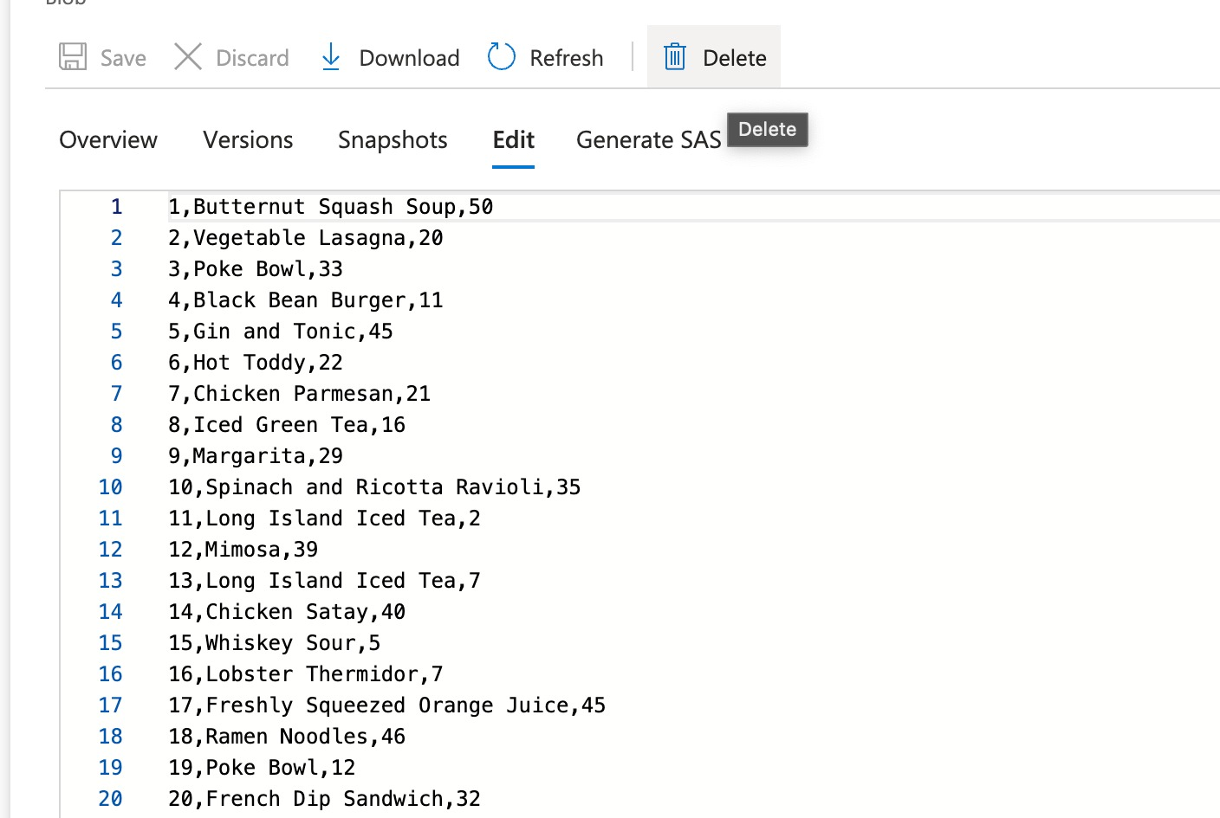
Blob data Storage

Slide 7
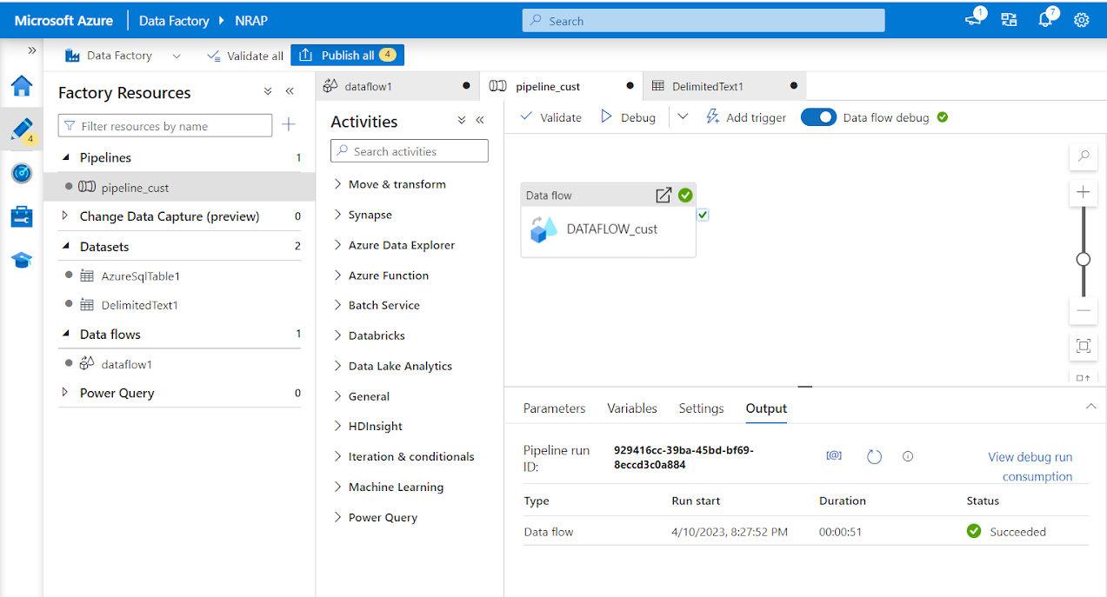
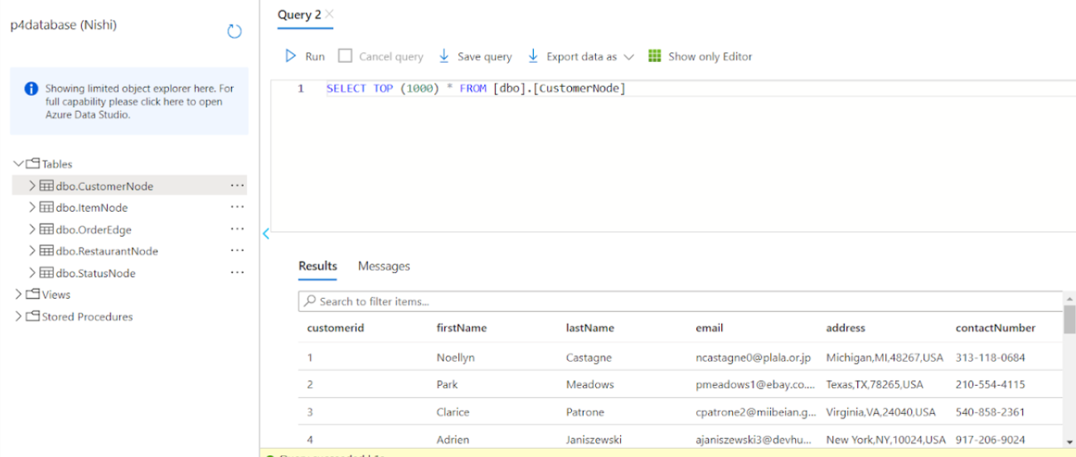
Azure Data Factory

Slide 8
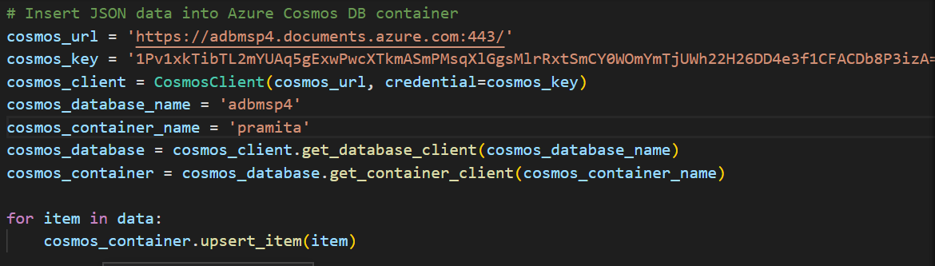
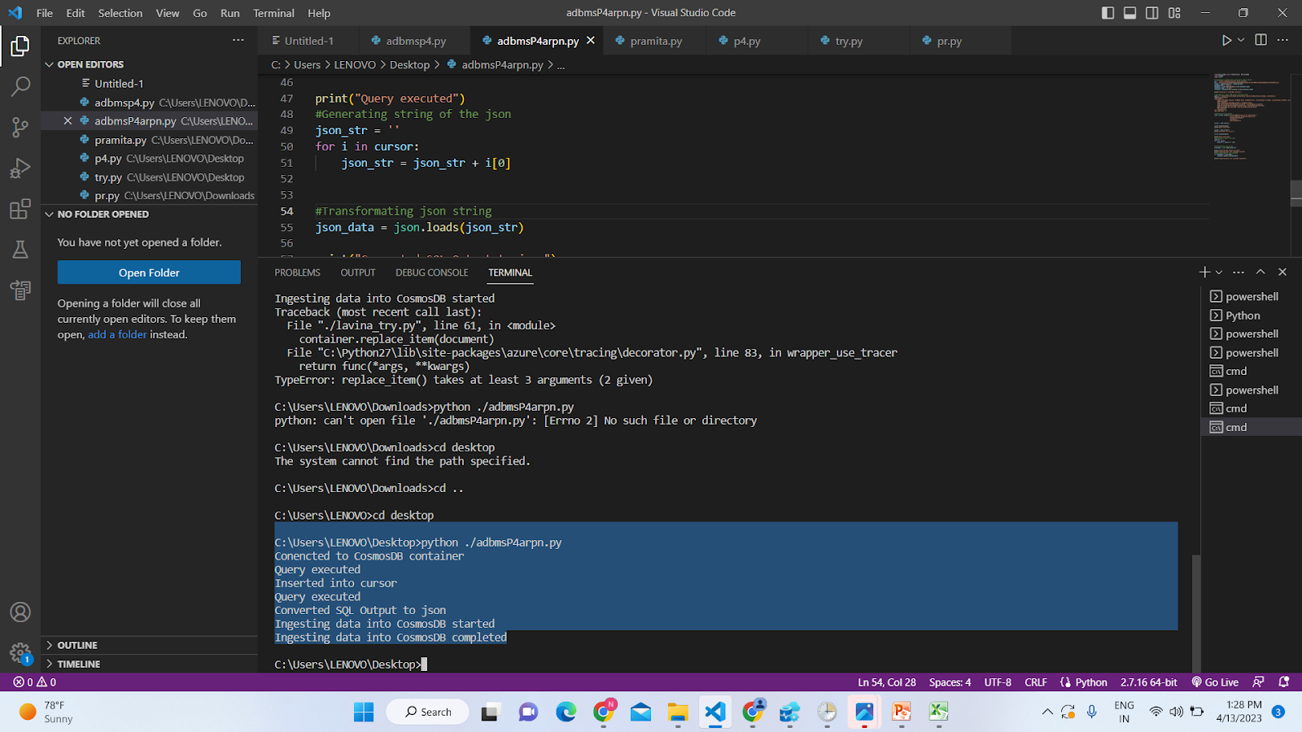
Python Script

Slide 9
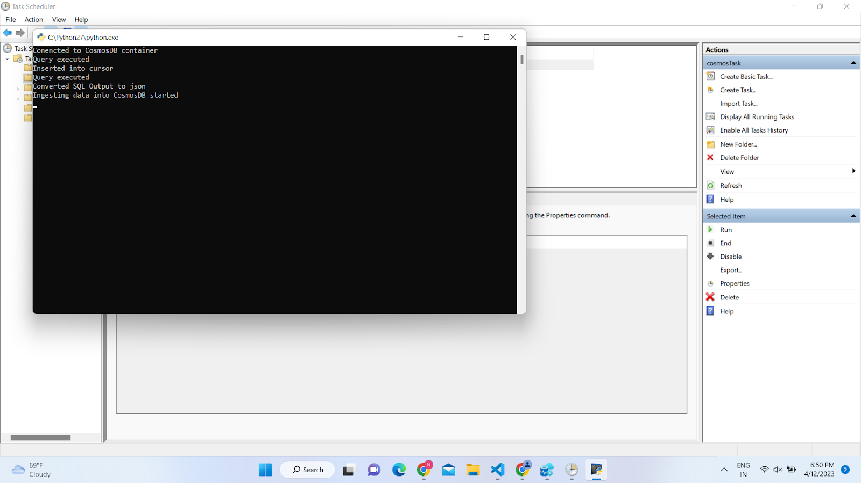
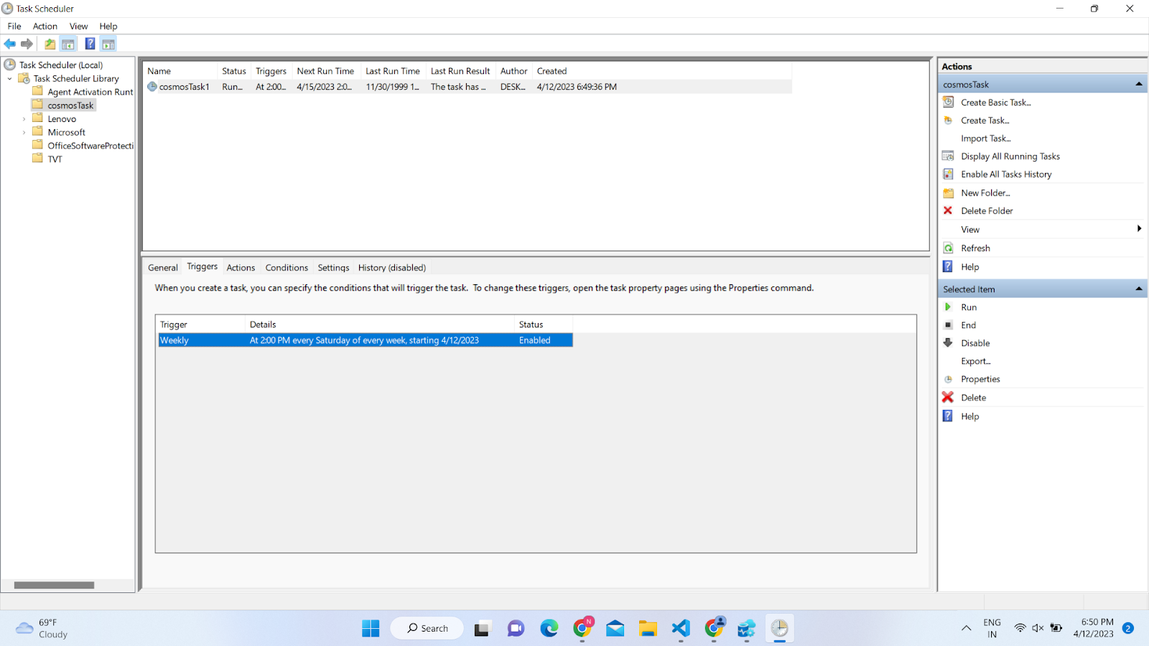
Task Schedular

Slide 10
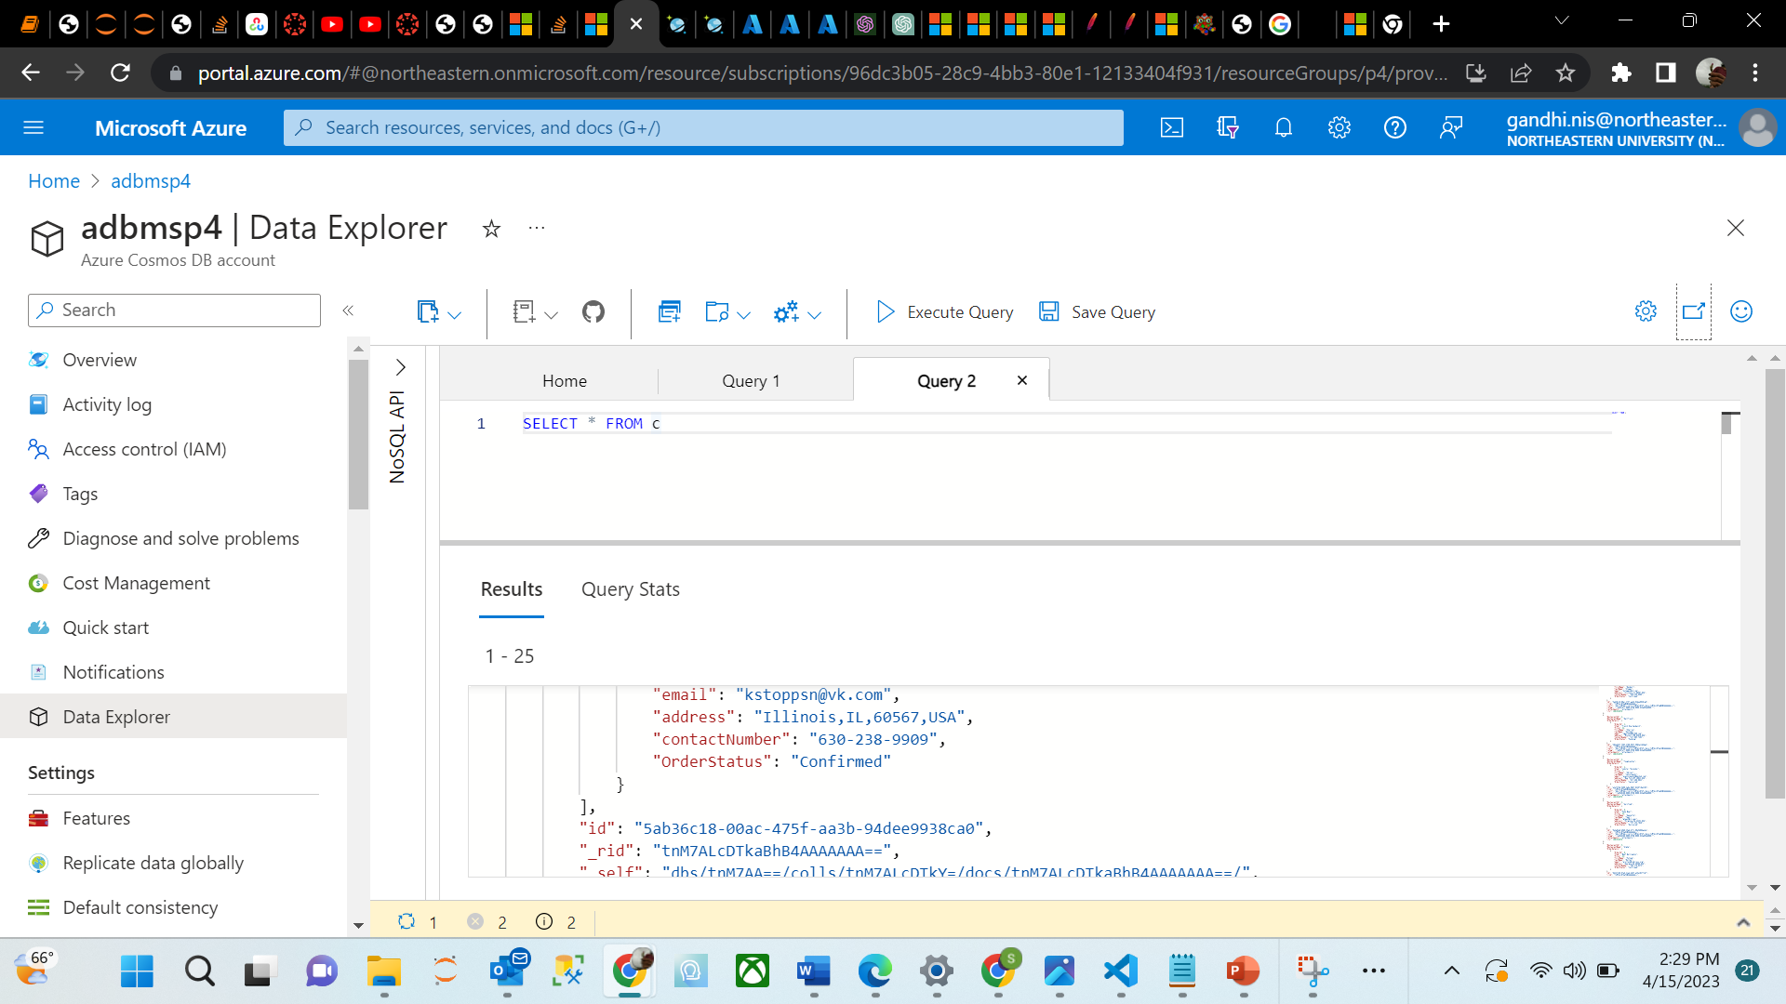
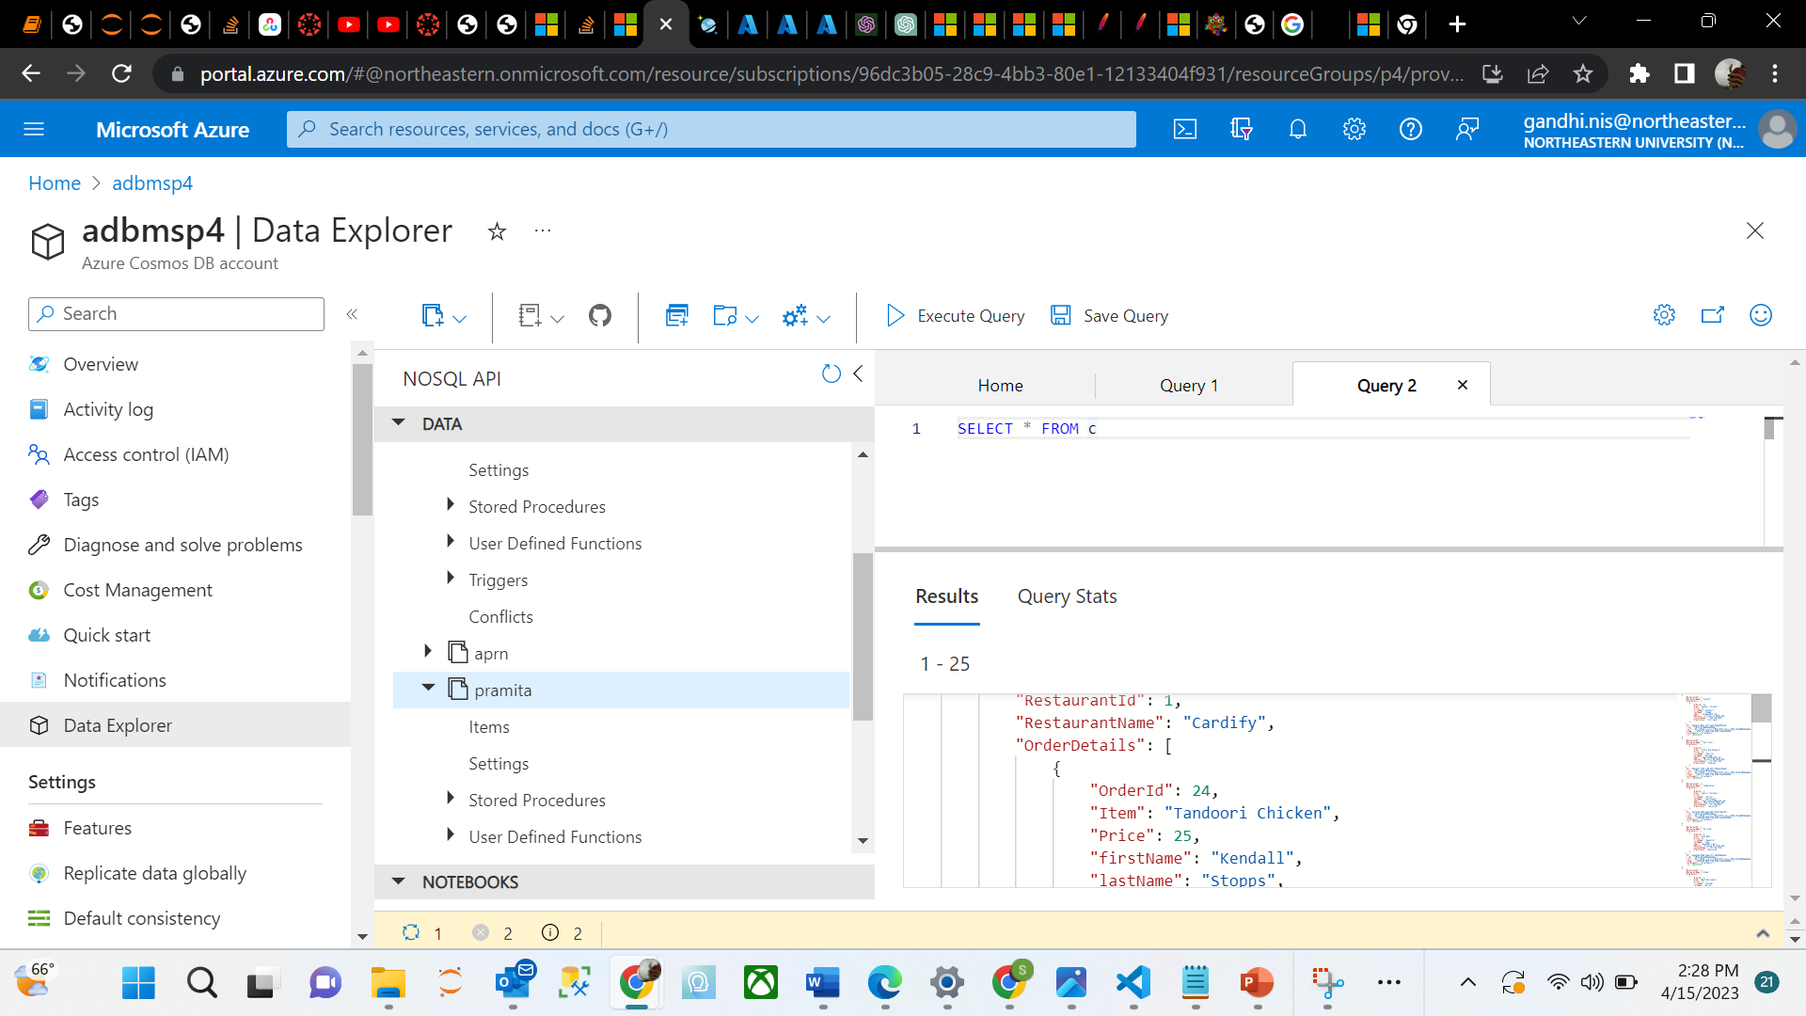
Azure Cosmos DB

Slide 11

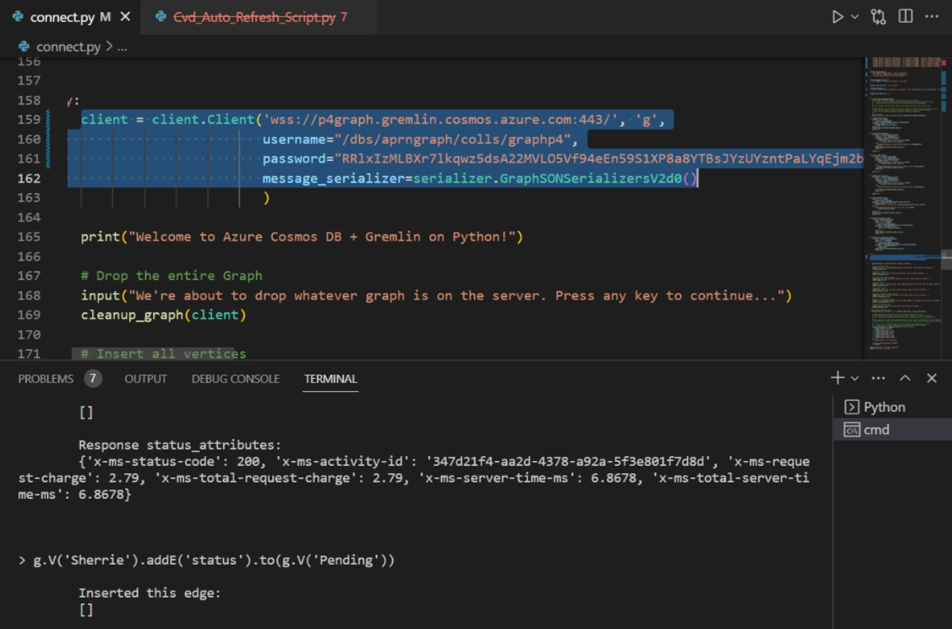
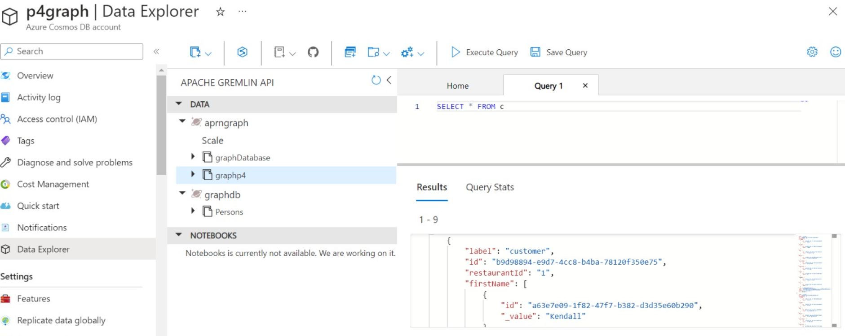
Graph database using Gremlin

Slide 12
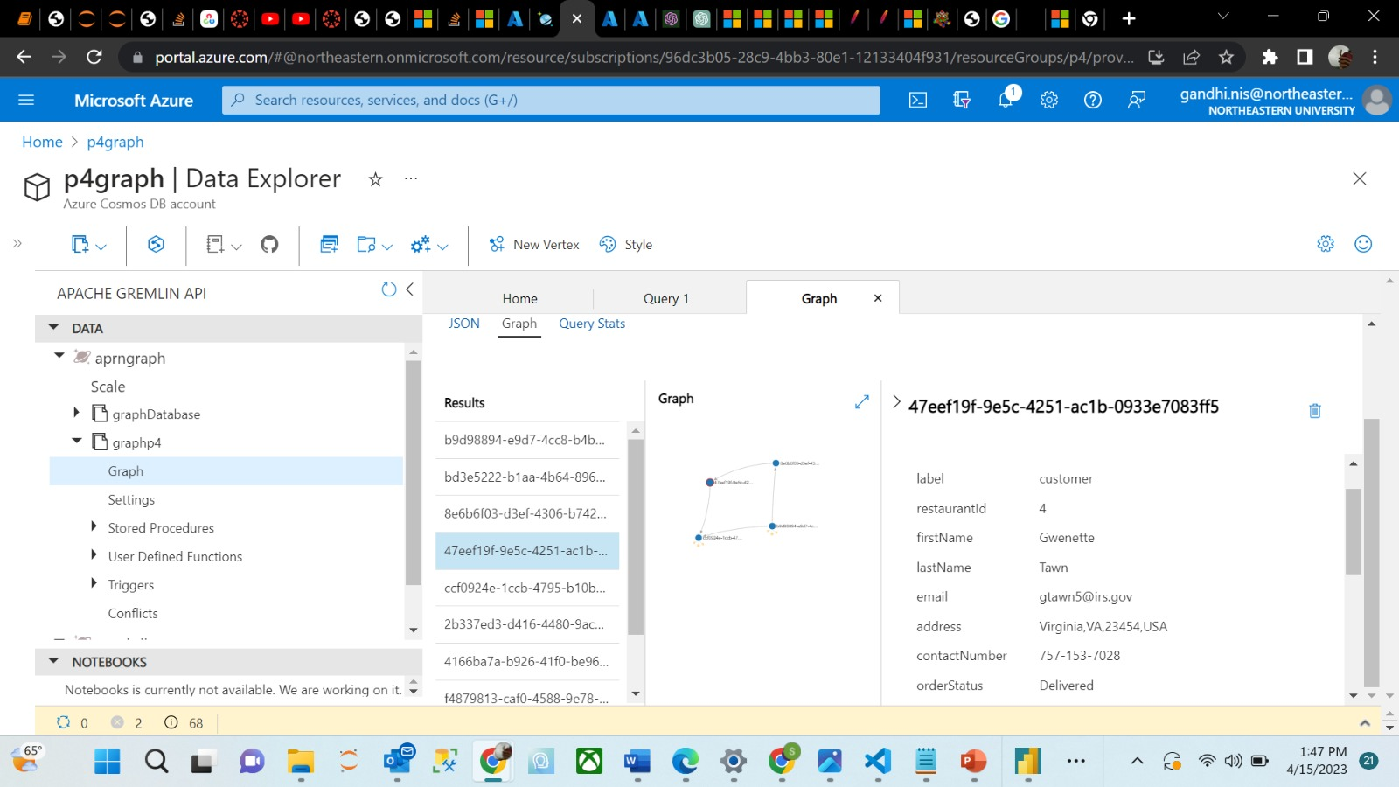
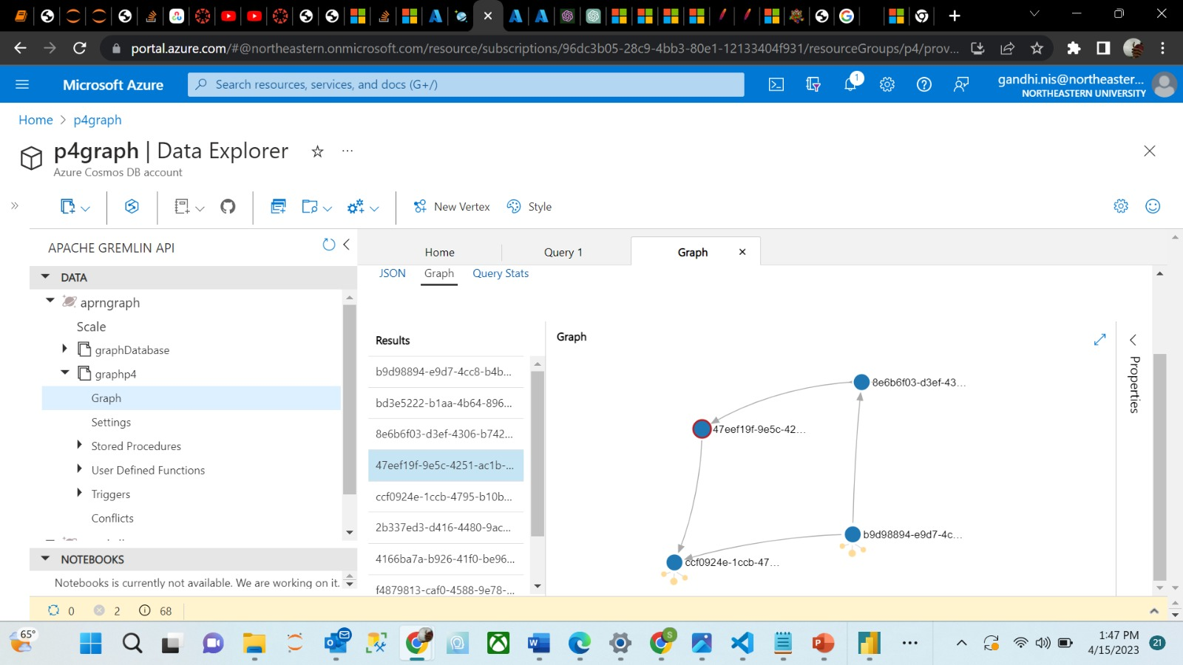

Slide 13
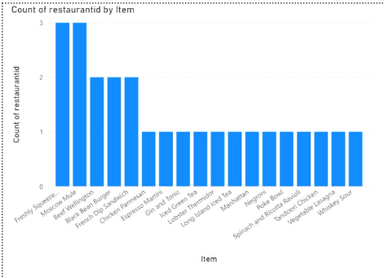
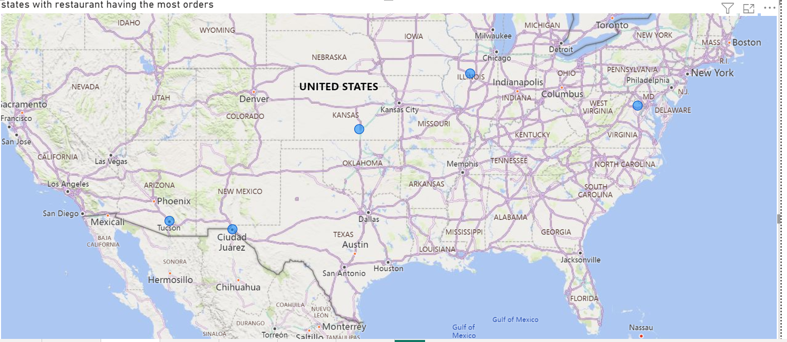
Visualization

Slide 14
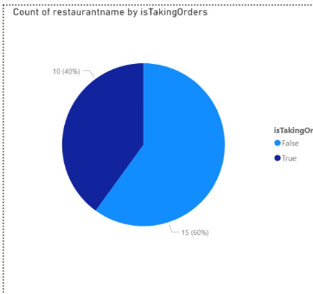
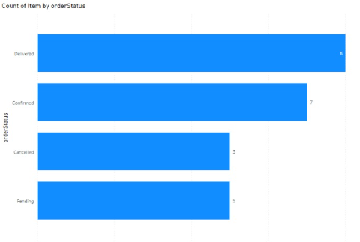

Slide 15
Thankyou

